Slide 1


AMERICAN INTERNATIONAL UNIVERSITY-BANGLADESH
Course of study: OBJECT ORIENTED PROGRAMMING 1 (JAVA)
Section - [N]
Directed by RAIMA ADHIKARY

Slide 2
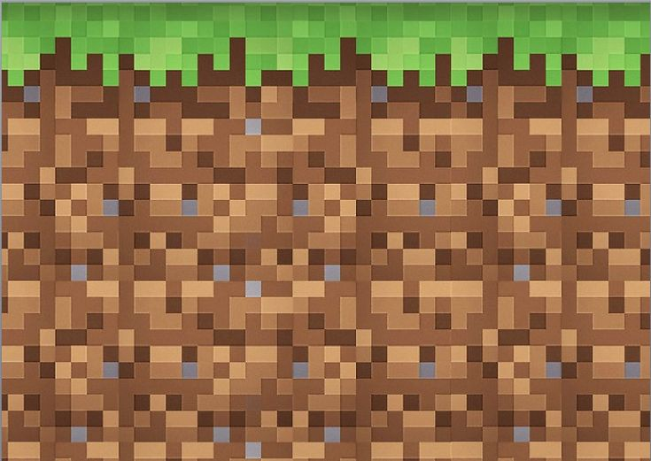
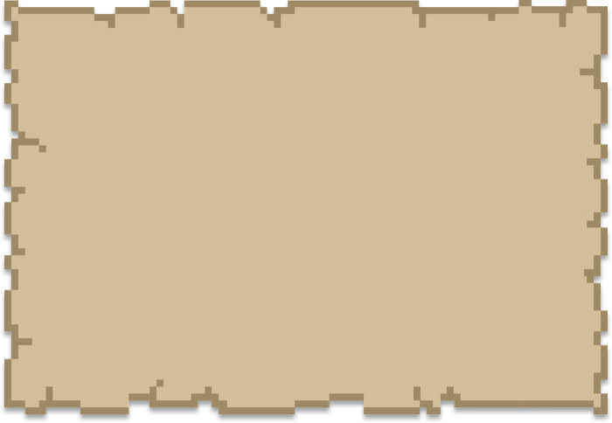
Creeper Clash…

Slide 3
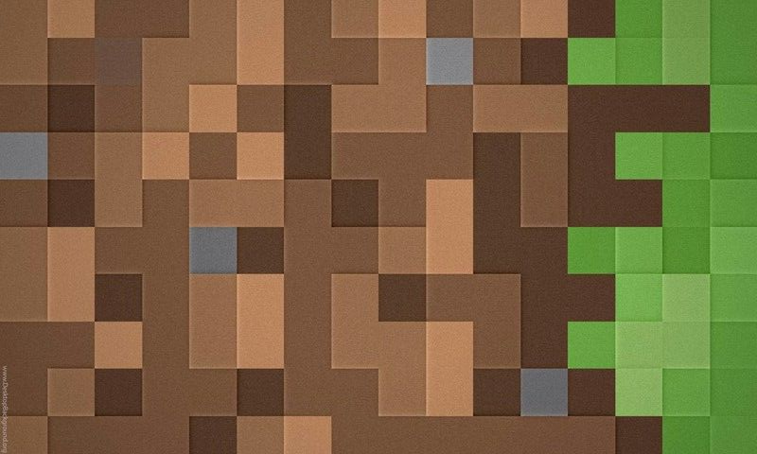
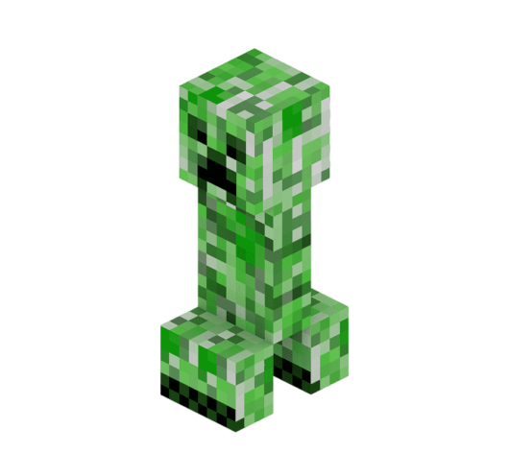
Group 03
Members | ID | Department
Sadia Farzana Anisha | 24-56562-1 | CSE
Sarita Islam Usmita | 24-56695-1 | CSE
Mufica Jebin | 24-56333-1 | CSE
Shahrin Mahbub Sama | 24-56212-1 | CSE

Slide 4
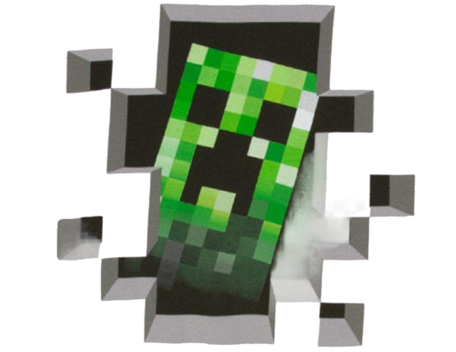
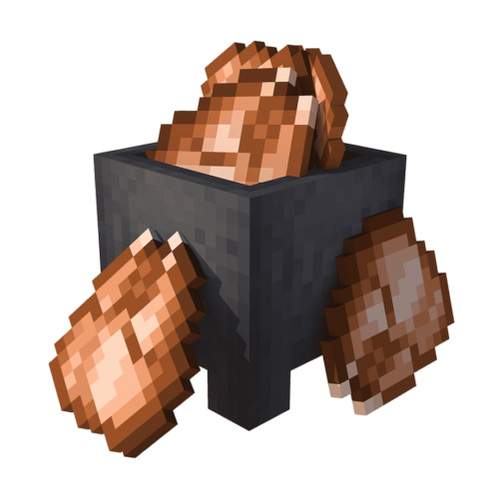
Introduction
Creeper Clash is a Java-based, Minecraft-themed game using OOP and GUI.
Players log in and register for a personalized experience.
Control a Minecraft chicken to dodge creepers, collect power-ups, and survive.

Slide 5


Features
Fully Object-Oriented Design: Uses encapsulation, inheritance, association, abstraction and polymorphism.
GUI-Based Gameplay: Built using Java Swing and AWT.
User Authentication System: Secure login and registration.
Game Mechanics: Includes movement, obstacles, and enemies.
Scoring System: Tracks and calculates scores.

Slide 6
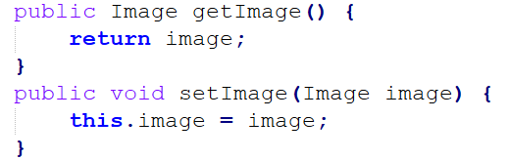
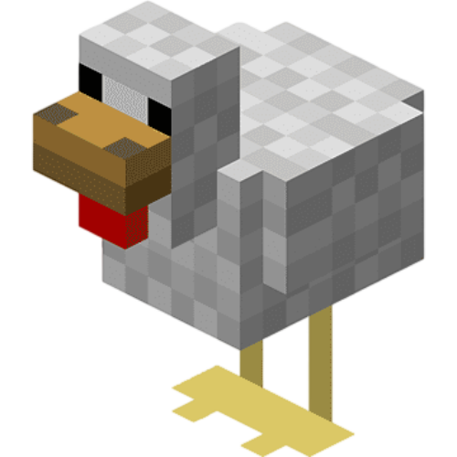
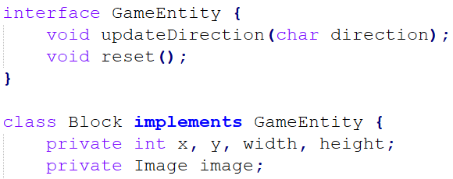
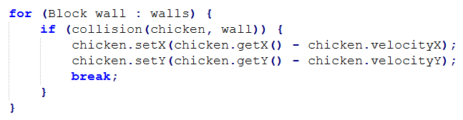
Object-Oriented Architecture
Encapsulation
Data hiding: Private attributes in Chicken.java, accessed via getters and setters.
Example: Block class encapsulates images, allowing controlled access.
Inheritance
Reusability through hierarchy:
GameEntity (Superclass) → Block (Subclasses).
Example: The Block class inherits movement logic from GameEntity.
Association
Objects interacting with each other:
Chicken interacts with Block (collision detection).
Login interacts with User for authentication.
Abstraction
Hides unnecessary details, exposing only essential behavior:
GameEntity is an abstract class defining shared behavior for Chicken and Creeper.
Polymorphism
Same method behaves differently in different classes
Updatedirection and reset method in Block and GameEntity behaves differently.

Slide 7
Other OOP Concepts Used in Creeper Clash
Object Creation: Chicken chicky = new Chicken();
Multiple Built-in & User-Defined Classes: Chicken.java, App.java, User.java etc.
Packages: Predefined packages like javax.swig, java.awt providing essential functionality for GUI, events and graphics.
User-Defined Methods & Constructors:
Methods: updateDirection(char direction)
Constructors: Initialize objects like User(String username, String password).
Exception Handling: Handles invalid user input using try-catch to prevent crashes during authentication.

Slide 8
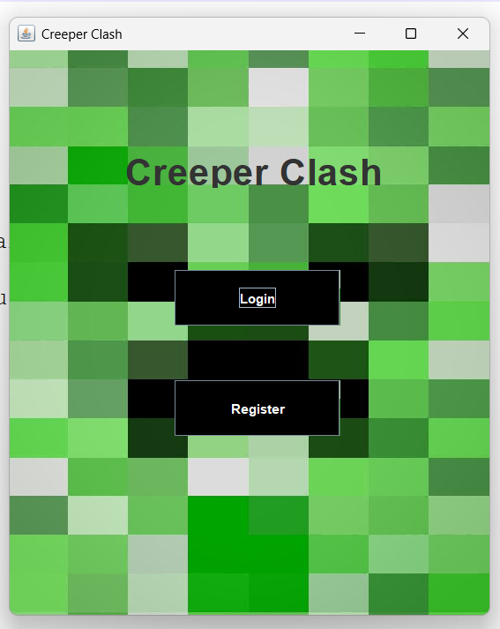
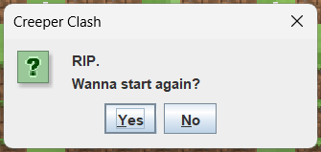
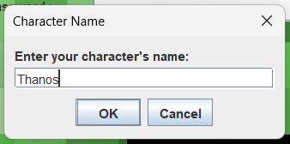
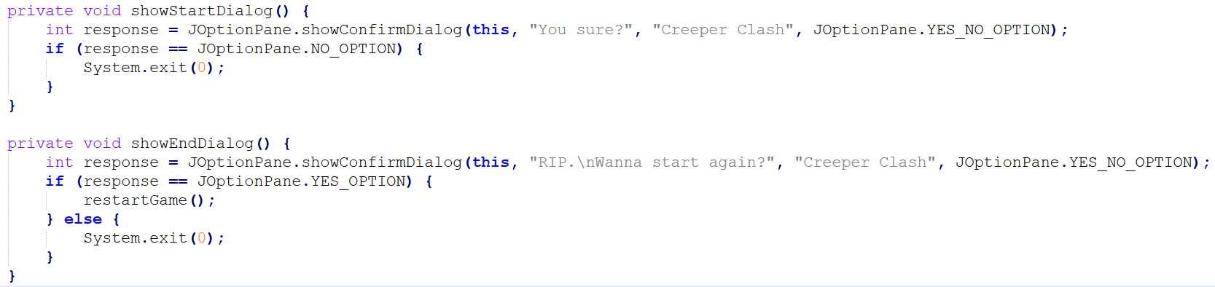
GUI Components Used
JFrame: Main window containing UI components like the game panel and other elements.
JPanel: Container for organizing and rendering components, used for game drawing surface.
JLabel: Displays static text like labels for username, score and dynamic game information.
JTextField & JPasswordField: For text and password input username, email, password.
JButton: Buttons for user actions like login, register, game over close.
JOptionPane: Displays dialog boxes for user prompts like game start, input name, game end.

Slide 9

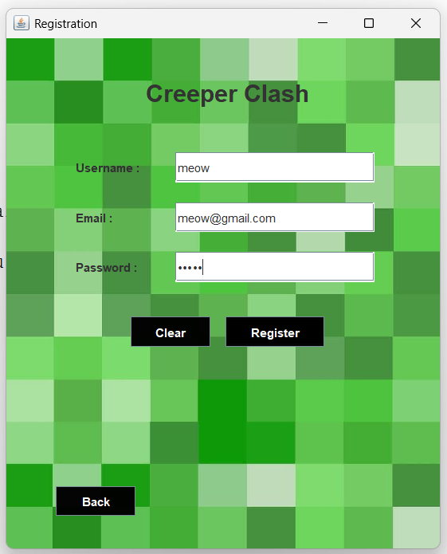
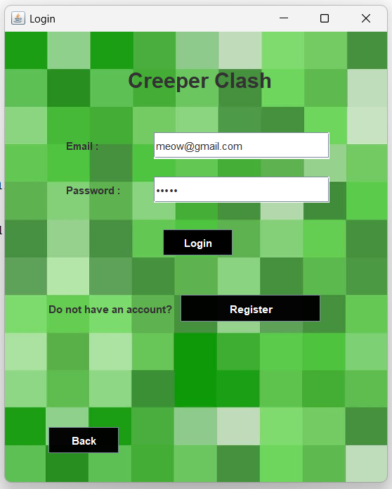
User Authentication System
Login System:
Users input their email and password to authenticate.
Passwords are securely compared to stored values in Userdata.txt.
Registration System:
Users can create a new account by providing a unique email, username, and password.
New users are added to the Userdata.txt file for future authentication.
File Handling: Data is stored and retrieved from Userdata.txt to keep track of users.

Slide 10
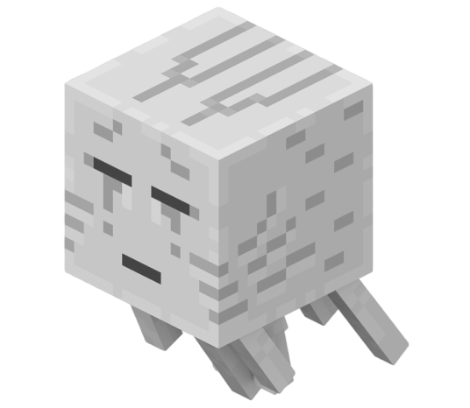
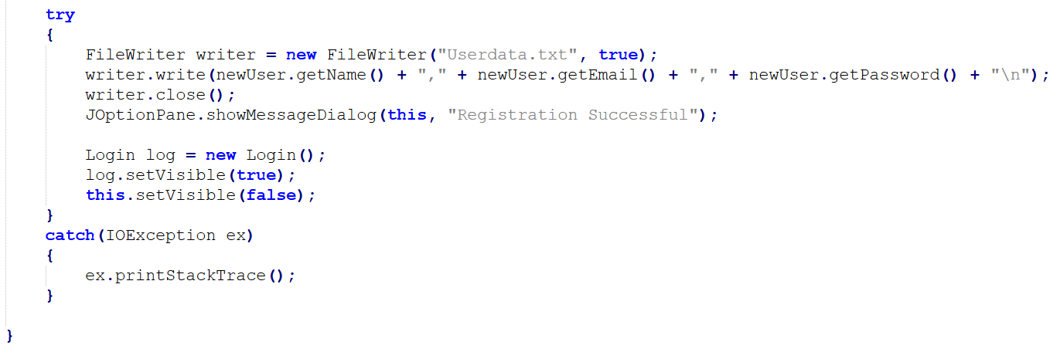

Game Navigation & Error Handling
Navigation Flow:
Main Menu: Options to login or register.
Login: Successful login redirects to dashboard, failure shows error.
Registration: New users sign up, then go to Login.
Error Handling:
Invalid Login: Displays error if email/password mismatch.
Registration Validation: Checks for empty fields and duplicate emails.
IOException: Handles file reading/writing errors.

Slide 11
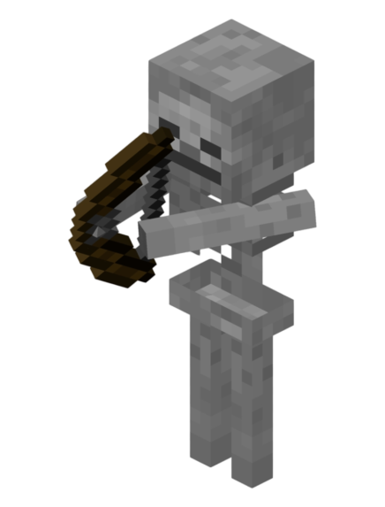
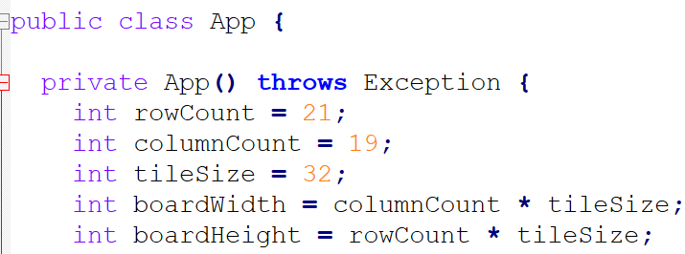
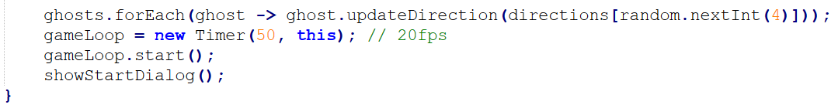
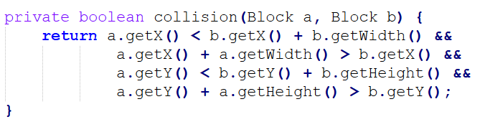
Game Logic and Physics
Game Window:
Dimensions: 21 rows x 19 columns, each tile 32px.
Non-Resizable, centered, and visible with JFrame.
Game Loop: Runs at 20fps, controlling game updates and redrawing.
Main Components:
Player (Chicken) Control: Movement through KeyListener (UP, DOWN, LEFT, RIGHT keys).
Entities: Chicken, creepers, walls, food items.
Collision Detection: Using collision(Block a, Block b) to detect interactions between chicken, creepers, walls, and food.
Effect: Stops movement at walls, loses lives when touching creepers, scores points when eating food.

Slide 12
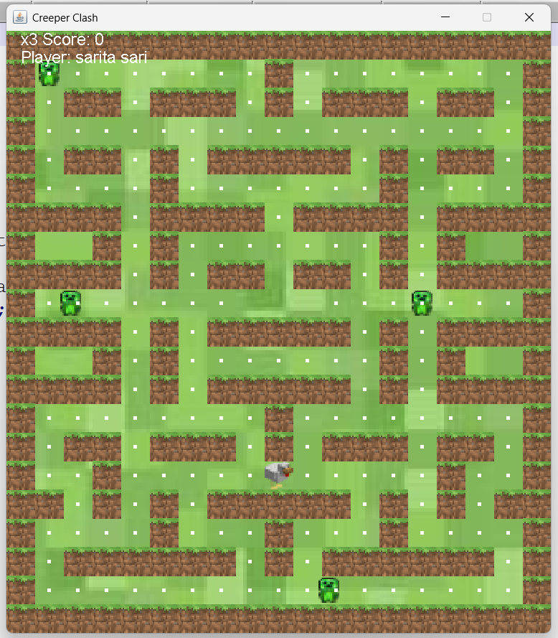
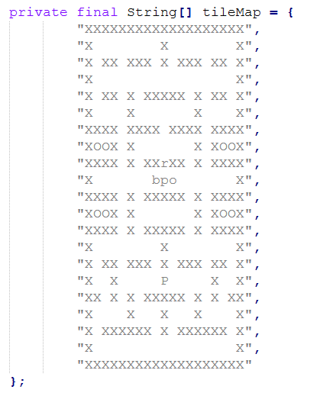

Map Design:
The map is represented as a 2D grid using a tileMap array.
Characters in the map ('X' for walls, 'b’, ‘p’, 'o' for creepers, 'P' for chicken, blank space for food).
Each character in the grid is converted into visual components (images for walls, creepers, food, etc.).

Slide 13
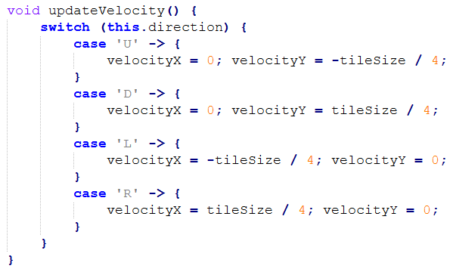
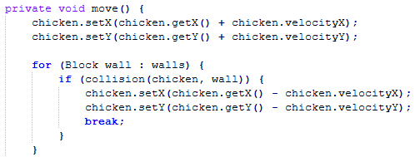
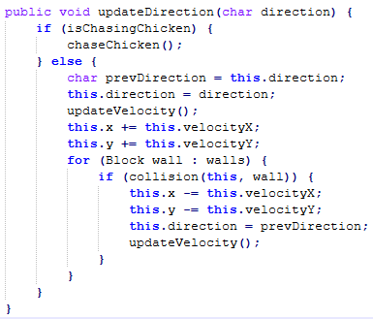
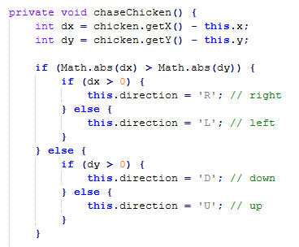
Movement, Physics & Ghost Behavior
Movement Physics:
Movement depends on direction (velocityX and velocityY based on tile size, tileSize / 4).
Smooth transitions between grid cells.
Chasing & Random Creepers:
Creepers move randomly until close to the chicken, then chaseChicken() method activates, adjusting direction based on relative position (dx, dy).
Pause & Reset:
Pause via the SPACE key.
Reset game entities (chicken, ghosts) on life loss or game restart using resetPositions().

Slide 14
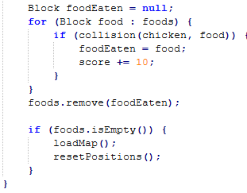
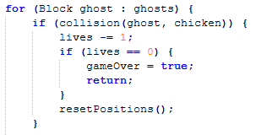
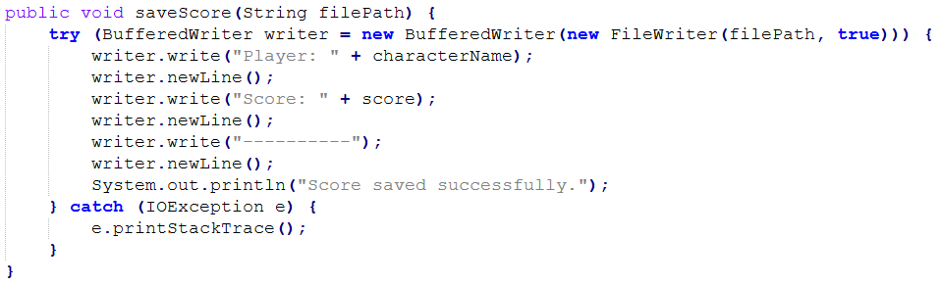
Scoring, Lives & File I/O
Score & Life System:
Score increases when food is eaten, tracked by foods.remove(foodEaten).
Lives decrease when ghosts touch the chicken, leading to game over after losing all lives.
Saving Scores:
Score saved to Score.txt using the saveScore() method (BufferedWriter).
After the game ends, scores are displayed in a new frame.
Map Refresh
When food is exhausted, a new map is loaded, and all entities are reset to their starting positions.

Slide 15
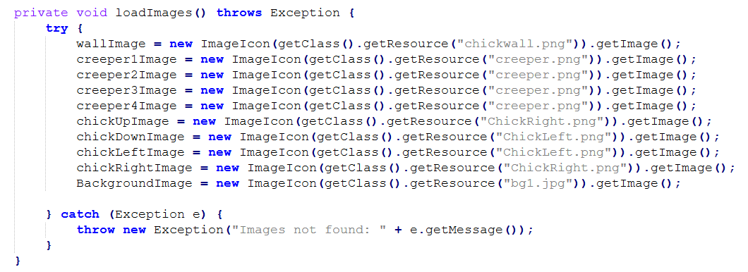
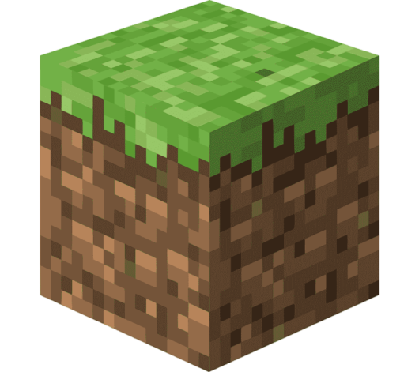
Images, Graphics, and UI Design
Images Loaded: Background, character (chicken), creepers, walls, and food.
Image Resizing: Images are resized to fit tiles on the grid (32x32 pixels).
Graphics Object: Used in the paintComponent method to render the game elements on the screen.
UI Components:
Score and lives displayed at the top.
Character name shown below score.
Dialog boxes for game start and game over.
Score saved to a file at the end of the game.

Slide 16
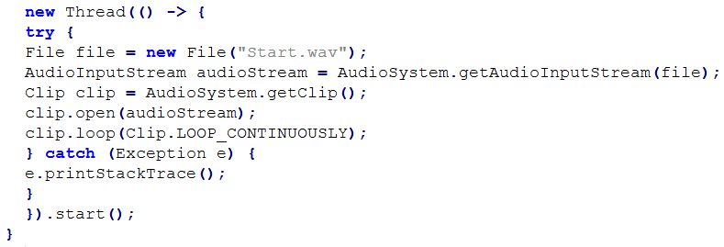
Audio and Sound Management
Sound Effects: Background music (Start.wav) plays continuously in a loop.
AudioClip: Used to manage sound, played on game start up.
Multithreading: Audio is handled in a separate thread to avoid blocking the main game loop.

Slide 17
Conclusion
Creeper Clash successfully integrates Java OOP concepts with GUI-based Minecraft-style gameplay.
The game demonstrates key OOP principles such as Encapsulation, Inheritance, Polymorphism, Association and Abstraction.
The project showcases Java’s capabilities in game development using GUI components like JFrame, JPanel, and KeyListener.
Overall, this project provides a strong foundation for developing object-oriented games in Java.

Slide 18
Thank you.

